Slide 1





AI INTEGRATED SMART SYSTEM MANAGEMENT
Name & Email id:A.MOHAMMED SUHAIL& suhailasik06@gmail.com
Guide:P.RAJA
Disclaimer: The content is curated for educational purposes only.
Notes:
Slides: Prepare a short slide deck (10-12 slides) summarizing the project objectives, methodology, and key results.

Slide 2
OUTLINE
Abstract of the Project
Problem Statement
Proposed Solution
System Architecture
Conclusion
Future Scope

Slide 3
Abstract
Water management is one of the crucial topics discussed in most of the international forums. Water harvesting and recycling are the major requirements to meet the global upcoming demand of the water crisis, which is prevalent. To achieve this, we need more emphasis on water management techniques that are applied across various categories of the applications. Keeping in mind the population density index, there is a dire need to implement intelligent water management mechanisms for effective distribution, conservation and to maintain the water quality standards for various purposes. The prescribed work discusses about few major areas of applications that are required for efficient water management.
Water is one of the most essential resources for human survival. However, with the growing population and changing climate patterns, water scarcity has become a significant issue in many parts of the world. In this context, the development of a smart water management system using IoT technology has become a necessity. This paper presents an overview of the development of a smart water management system using IoT technology. The proposed smart water management system consists of several components such as sensors, communication devices, and a central server. The sensors are installed at various locations such as water sources, distribution networks, and consumer premises to collect data on water usage, quality, and availability. The collected data is transmitted to the central server through communication devices such as Wi-Fi, Zigbee, or Lora WAN. The central server processes the data and provides real-time information on water usage, quality, and availability. This information is then used to optimize the water distribution network and reduce wastage.

Slide 4
Problem Statement
Water scarcity and inefficient water usage are growing concerns in both urban and rural areas, exacerbated by factors such as climate change, population growth, and inadequate infrastructure. Traditional water management systems are often reactive, relying on manual monitoring, scheduled irrigation, and static water distribution methods. These systems fail to dynamically adapt to real-time changes in water demand, environmental conditions, and consumption patterns, leading to waste, inefficiency, and, in some cases, water shortages.
The challenge is to design an AI-integrated smart water management system that optimizes water usage, improves distribution efficiency, and ensures sustainability.
Those are recent trends in wastewater recycle, water distribution, rainwater harvesting and irrigation management using various Artificial Intelligence (AI) models. The data acquired for these applications are purely unique and also differs by type. Hence, there is a dire need to use a model or algorithm that can be applied to provide solutions across all these applications. Artificial Intelligence (AI) and Deep Learning (DL) techniques along with the Internet of things (IoT) framework can facilitate in designing a smart water management system for sustainable water usage from natural resources. This work surveys various water management techniques and the use of AI/DL along with the IoT network and case studies, sample statistical analysis to develop an efficient water management framework.

Slide 5
Proposed Solution
The management of water resources is an essential aspect of sustainable development, and it is critical to the success of many industries, such as agriculture, energy, and urbanization. Due to the increasing demand for water resources, the need for efficient and smart water management systems is becoming more important. The Internet of Things (IoT) technology is a suitable solution to tackle the issue of water management. This proposed system aims to develop a smart water management system using IoT technology to address the water scarcity problem.
Water scarcity is a significant problem in many parts of the world, and it is expected to increase with the rise in population and economic growth. The traditional water management systems are not efficient enough to handle the increasing demand for water. There is a need for smart water management systems that can provide real-time data and optimize the water distribution process. The Io T technology is a suitable solution to address the issue of water management. Io T is a network of devices that are connected to the internet and can communicate with each other.
Central System: The central system will receive the data transmitted by the sensors and analyze it to provide insights into the water supply network. The system will use machine learning algorithms to predict the demand for water and optimize the distribution process. This system can collect data from various sources, analyse it, and provide valuable insights to improve water management. This paper discusses the design and implementation of a smart water management system using Io T technology.

Slide 6
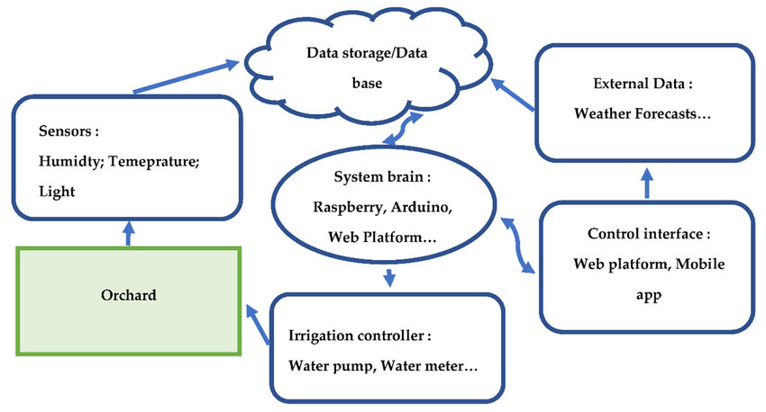
System Architecture

Slide 7
Conclusion
Water utilities worldwide are undergoing a digital transformation and are can be driven by the internet, big data, and AI algorithms. To remain competitive and improve customer service delivery, water utilities need to shift from an “old school” operation, as a result of operating a monopoly with little external pressure, or Hydraulic Modeling 1.0, to a new era of efficiency and accountability, or Hydraulic Modeling 2.0. The availability of affordable big data from sensors, customers, and staff drives this transformation. Access to information is not knowledge, as big data needs to be processed further for operational and planning decisions. Artificial intelligence algorithms help the water utility to become more data-efficient by transforming information into a leaner operation, boosting data-driven decision making through a combination of AI numerical tools and human operational skills.Such digital transformation to become a “smart” water utility goes beyond the technical challenge of integrating data, but also requires a new organization structure, and new sets of operational procedures with buy-in from the staff and the consumers. A new set of national and sector policies is needed to support this digital transformation of the water sector; specifically, to improve .
This brief presented the current trends in application of advanced technologies and techniques, especially AI algorithms, in water supply in general and for the prognosis of UFW in particular. Even though there are many AI tools for many different applications, the most promising ones for water distribution network analysis and UFW estimation are those based on a combination of physically based and data-driven models. Physically based methods are the way forward for water utilities to start their digital transformation into smart water.

Slide 8
Future Scope
The future scope for AI-integrated smart water system management holds significant promise in transforming how water resources are monitored, distributed, and conserved. AI can enhance predictive maintenance by anticipating infrastructure failures, reducing costs and downtime. It will enable smarter water distribution by analyzing demand patterns and optimizing supply, ensuring efficient use and equitable distribution, especially in regions with limited water resources. AI can also improve water quality monitoring, detecting contaminants in real-time and enabling quick interventions to maintain safe water standards. Additionally, AI-powered systems can detect leaks and prevent water loss, helping to address inefficiencies in aging infrastructure. Forecasting water demand based on weather patterns and historical data will allow for better conservation strategies and more sustainable usage. AI can support climate change adaptation by predicting extreme weather events and enabling the design of more resilient water systems. As these systems evolve, fully automated water management could become a reality, minimizing human intervention while maximizing efficiency. With continuous advancements, AI will play a crucial role in optimizing water recycling, improving operational decision-making, and driving long-term sustainability n global water management practices.

Slide 9
Thank you!
Notes:
thank you very much for joining this PPT, keep learning.

